Slide 1

Informative Seafloor Exploration for Benthic Habitat Mapping
Kelvin Hsu

Slide 2

How much of the ocean seafloor have we mapped?
Notes:
I want to start off by asking: How much of the ocean do you think we have mapped?

Slide 3
How much of the ocean seafloor have we mapped?
“95% of the ocean remains unexplored”
Notes:
There is this general consensus that we have only explored 5% of the seafloor, leaving 95% untouched.

Slide 4
How much of the ocean seafloor have we mapped?
“95% of the ocean remains unexplored”
100% mapped at resolution of 5 km
Notes:
But actually, we do have a map of the entire ocean floor, just at a very crude resolution of 5 km – and this is done by some very smart satellite observation techniques.

Slide 5
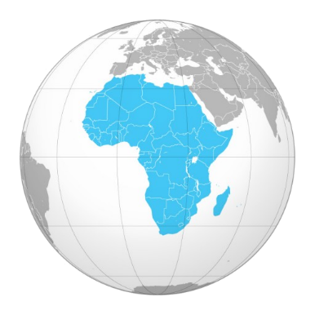
How much of the ocean seafloor have we mapped?
“95% of the ocean remains unexplored”
100% mapped at resolution of 5 km
10% to 15% mapped at resolution of 100 m
Notes:
If you want better resolutions at 100 meters, we have still have around 10% to 15% of our planet’s ocean mapped, which is around the size of Africa. And this is done by using SONAR techniques from ships sailing across the sea. However, that’s just the structural features of the seafloor, which we call Bathymetric features.

Slide 6
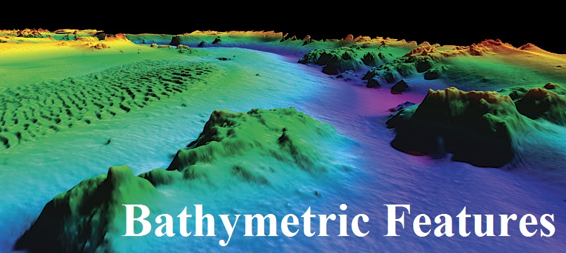
How much of the ocean seafloor have we mapped?
“95% of the ocean remains unexplored”
100% mapped at resolution of 5 km
10% to 15% mapped at resolution of 100 m
Notes:
That’s not really want we want to know. What we really want to know about are the types of habitat environments that exists at those seafloor regions. We call these Benthic Habitats.

Slide 7
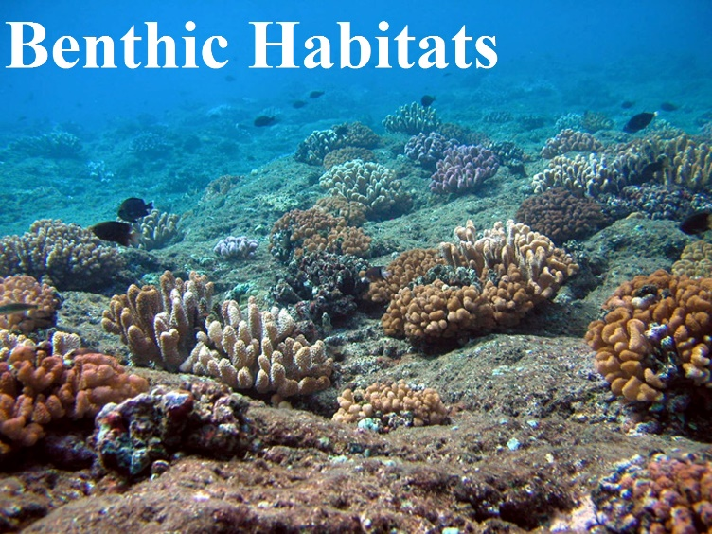
How much of the ocean seafloor have we mapped?
“95% of the ocean remains unexplored”
100% mapped at resolution of 5 km
10% to 15% mapped at resolution of 100 m
Notes:
So how much of THOSE regions have we actually visited?

Slide 8
How much of the ocean seafloor have we mapped?
“95% of the ocean remains unexplored”
100% mapped at resolution of 5 km
10% to 15% mapped at resolution of 100 m
Less than 0.05% actually visited!
Notes:
Surprisingly, only 0.05%! For a planet which is 70% covered with ocean, we really do not know much about the Earth’s most abundant type of habitats.

Slide 9

How much of the ocean seafloor have we mapped?
“95% of the ocean remains unexplored”
100% mapped at resolution of 5 km
10% to 15% mapped at resolution of 100 m
Less than 0.05% actually visited!
Notes:
This is why we deploy Autonomous Underwater Vehicles, or AUVs, to take pictures of those benthic habitats so that we can build a good map of it. But the problem is this. There is so much of the seafloor to explore.

Slide 10
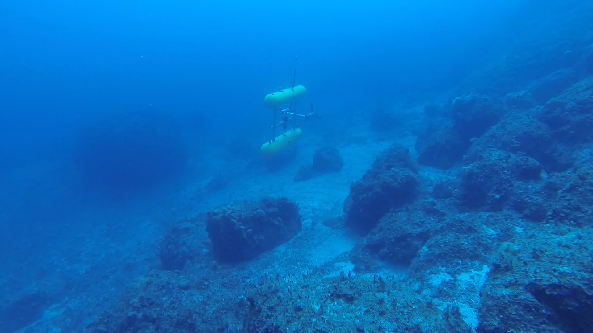
Informative Seafloor Exploration
for
Benthic
Habitat
Mapping
Knowing the Bathymetry… which way should I go?
Notes:
Here is an AUV taking pictures of the benthic seafloor. As you can see, unlike using SONAR from floating ships, AUVs travel much slower underwater and are also more expensive due to the mission costs. They also run out of battery power every tens of kilometres. Basically, AUVs cannot map benthic habitats at the rate ships have mapped seafloor bathymetry using SONAR. This raises the question, how should we best explore the seafloor in order to map the benthic habitats under cost and time constraints?
My name is Kelvin, and today I would like to chat to you about informative seafloor exploration for benthic habitat mapping. The idea is for the AUV to focus on exploring the most ‘informative’ places so that the vehicle can obtain the most essential information regarding the seafloor in order to map the benthic habitats more quickly. This is a form of an informative path planning problem. There are two parts to this thesis: the path planning part, and the mapping part. We will talk about mapping first.

Slide 11
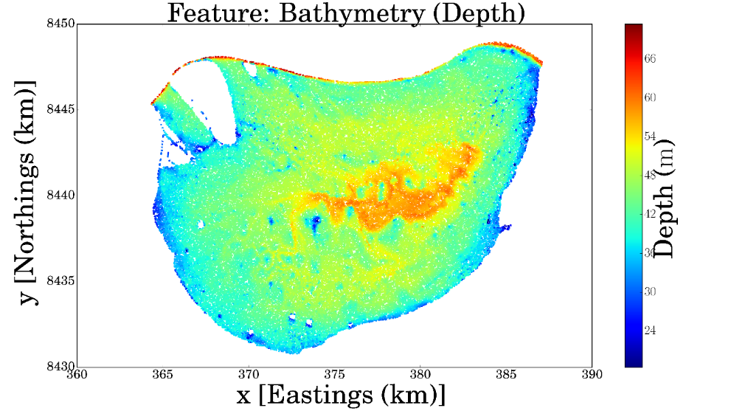
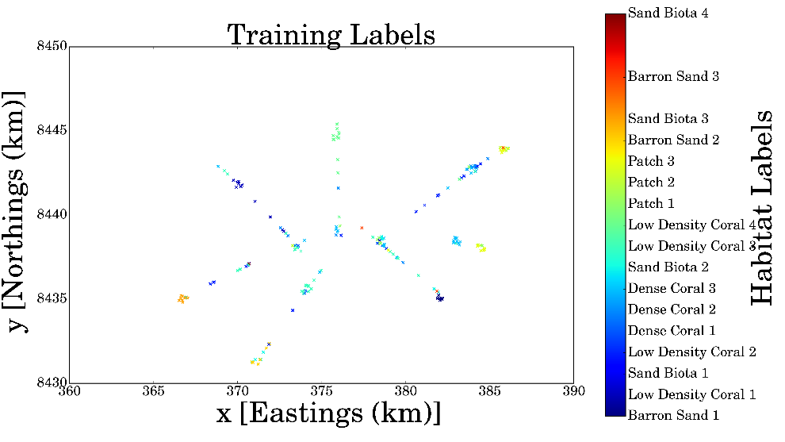
Benthic Habitat Mapping
Notes:
So the basic Benthic Habitat Mapping Problem is this. Here is an typical example using the dataset from Scott Reef, Western Australia. On the left is a map of the bathymetric depth of the seafloor, and on the right are the habitat types or labels. For example, we’ve got here Sand Biota, Dense Coral, Barron Sand.
We know from just now that there are lot of regions with plenty of bathymetric data. The idea is to learn a relationship between the habitat types and the bathymetric features at places that we have been before, and use that to infer the habitat types based on the bathymetric features at places that we haven’t been to.
Also, notice that we are modelling the habitat type on the bathymetric features of the habitats, not on the location of the habitats. This is because we expect that habitat types are more correlated with the local seafloor terrain structure instead of its location – it doesn’t really matter where it is. More importantly, this is what allows the vehicle to infer places that are potentially far away but have similar bathymetric signature as a habitat it has observed before.
Put Bathy + Labels = Map Animation and The Pictures
EDIT: Put Bathy + Labels = Map Animation (Show The Images)

Slide 12
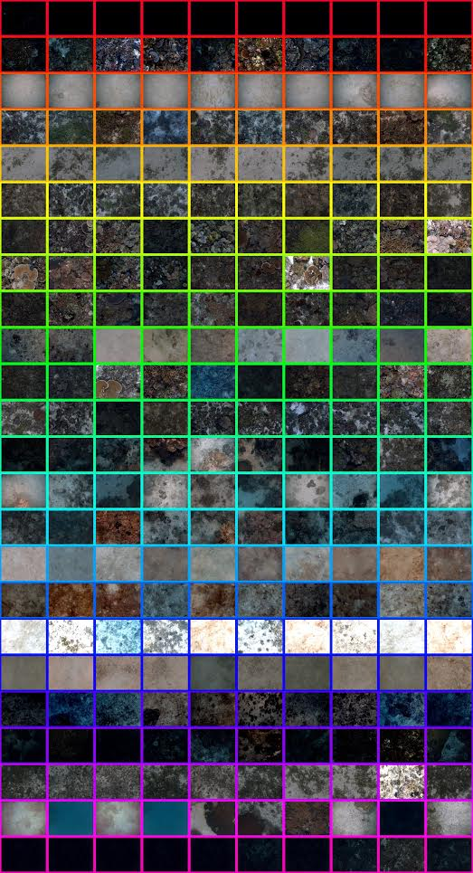
Benthic Habitat Mapping
Notes:
So the basic Benthic Habitat Mapping Problem is this. Here is an typical example using the dataset from Scott Reef, Western Australia. On the left is a map of the bathymetric depth of the seafloor, and on the right are the habitat types or labels. For example, we’ve got here Sand Biota, Dense Coral, Barron Sand.
We know from just now that there are lot of regions with plenty of bathymetric data. The idea is to learn a relationship between the habitat types and the bathymetric features at places that we have been before, and use that to infer the habitat types based on the bathymetric features at places that we haven’t been to.
Also, notice that we are modelling the habitat type on the bathymetric features of the habitats, not on the location of the habitats. This is because we expect that habitat types are more correlated with the local seafloor terrain structure instead of its location – it doesn’t really matter where it is. More importantly, this is what allows the vehicle to infer places that are potentially far away but have similar bathymetric signature as a habitat it has observed before.
Put Bathy + Labels = Map Animation and The Pictures
EDIT: Put Bathy + Labels = Map Animation (Show The Images)

Slide 13
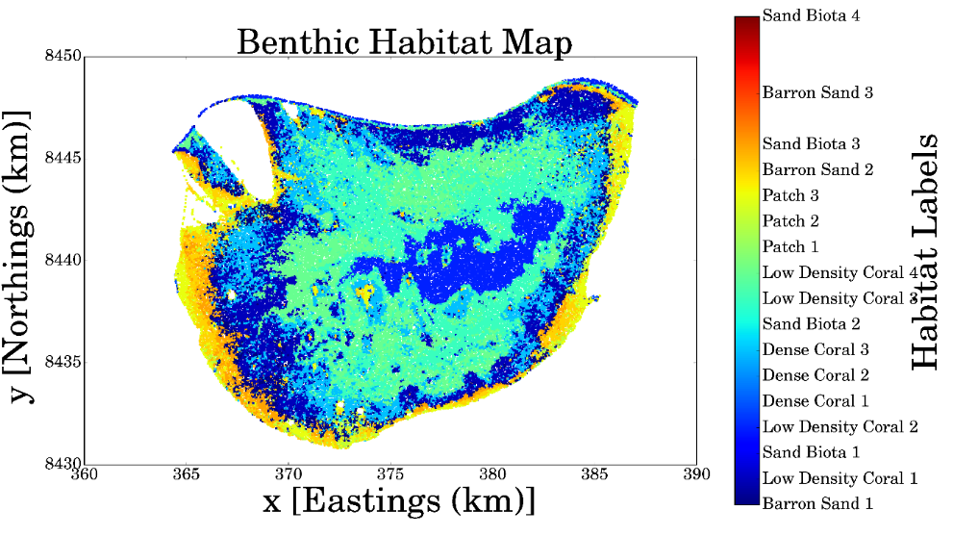
Benthic Habitat Mapping
Notes:
So the basic Benthic Habitat Mapping Problem is this. Here is an typical example using the dataset from Scott Reef, Western Australia. On the left is a map of the bathymetric depth of the seafloor, and on the right are the habitat types or labels. For example, we’ve got here Sand Biota, Dense Coral, Barron Sand.
We know from just now that there are lot of regions with plenty of bathymetric data. The idea is to learn a relationship between the habitat types and the bathymetric features at places that we have been before, and use that to infer the habitat types based on the bathymetric features at places that we haven’t been to.
Also, notice that we are modelling the habitat type on the bathymetric features of the habitats, not on the location of the habitats. This is because we expect that habitat types are more correlated with the local seafloor terrain structure instead of its location – it doesn’t really matter where it is. More importantly, this is what allows the vehicle to infer places that are potentially far away but have similar bathymetric signature as a habitat it has observed before.
Put Bathy + Labels = Map Animation and The Pictures
EDIT: Put Bathy + Labels = Map Animation (Show The Images)

Slide 14
Bathymetric Features
Notes:
Of course, the structure of the terrain isn’t just determined by the depth. From the depth data, we can actually extract more bathymetric features that summarises the local terrain structure.

Slide 15
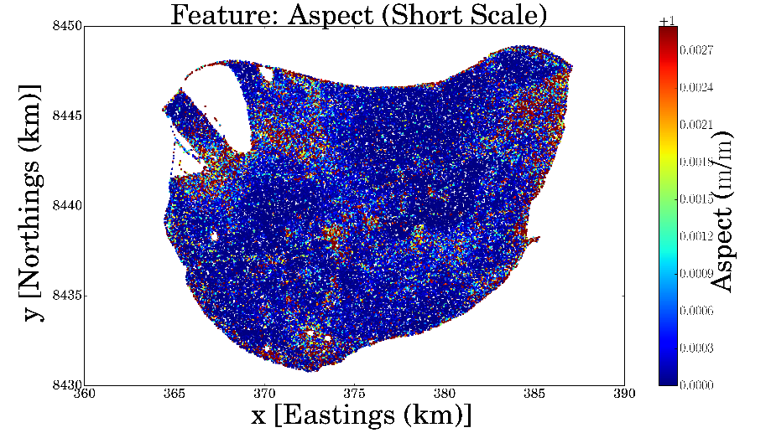
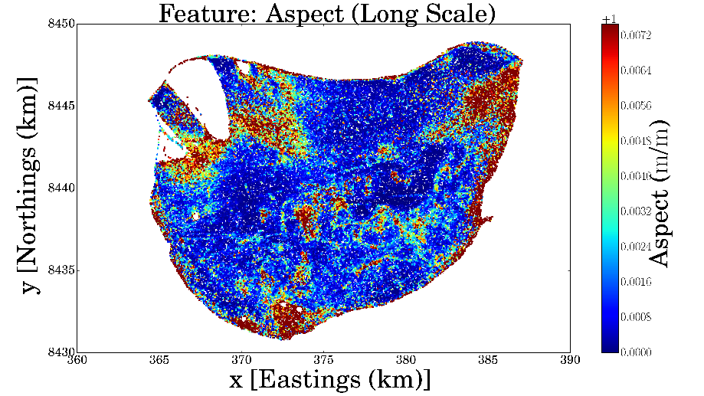
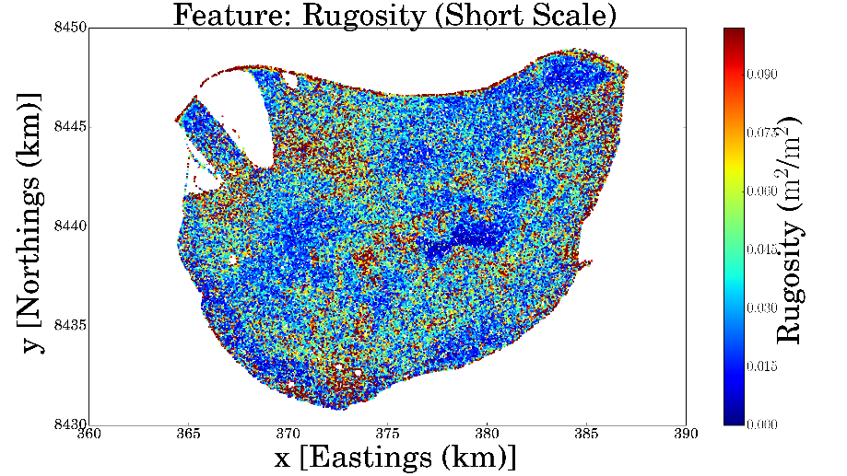
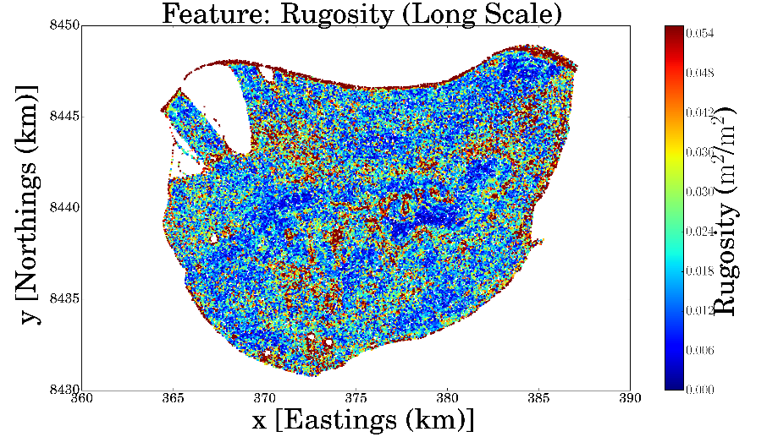
Bathymetric Features
Notes:
For the Scott Reef dataset, we extracted the aspect and rugosities at short scales and long scales. Aspect is just another word for the terrain slope, and rugosity simply refers to the local roughness of the terrain. Along with depth, we will model the habitat types using these five bathymetric features.

Slide 16
Gaussian Processes for Bayesian Modeling
Bayesian and Non-Parametric Model
Flexible
Infinite dimensional extension of a multivariate Gaussian distribution
Notes:
So, we need to learn a relationship between input variables – the bathymetric features, and an output variable – the habitat type. This means we need to develop some sort of inference model.
One of the most awesome tools in machine learning are Gaussian processes. These are Bayesian and Non-Parametric models that are able to model a variety of phenomena! By Bayesian we mean that instead of trying to predict a point value, it tries to infer a probabilistic distribution of its prediction. By Non-Parametric, we mean that its model structure isn’t determined directly by parameters. For example, a linear model has intercept and slope parameters that directly determines the shape of the model. Here, we don’t have that sort of thing, which makes this model very flexible.
The most important assumption, however, is that points closer to each other in the feature space are more correlated. And notice that it’s how close they are in feature space, which is not necessarily your spatial space. So in our case, if two places are very far away but they both have similar depth, aspect, and rugosity, then they are deemed very correlated by the GP model.
-Gaussian process: Non-Parametric and Bayesian Model
-Explain “Bayesian” and “Non-Parametric”
It is a Stochastic Process that generalises the usual multivariate Gaussian distribution. In fact, it can be seen as an infinite dimensional Gaussian distribution. As such, it can be used to model functions, instead of just finitely many variables.
-Define a GP
-Prior/Posterior

Slide 17
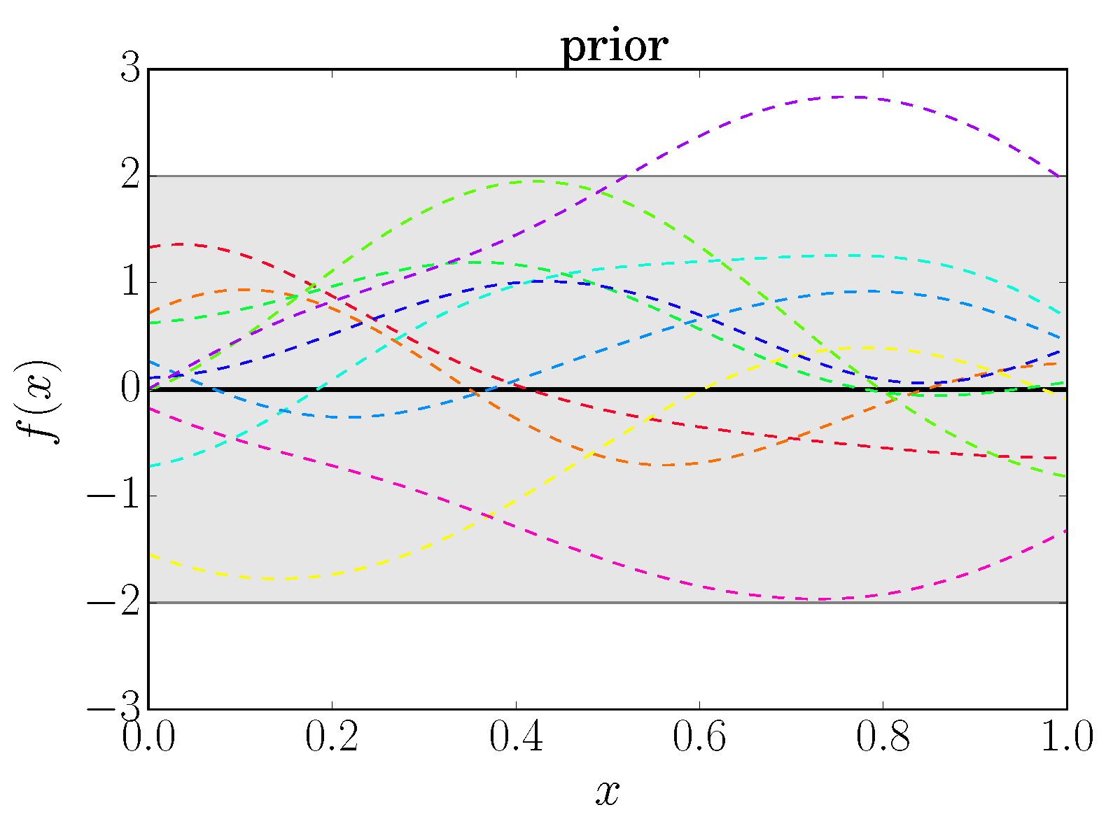
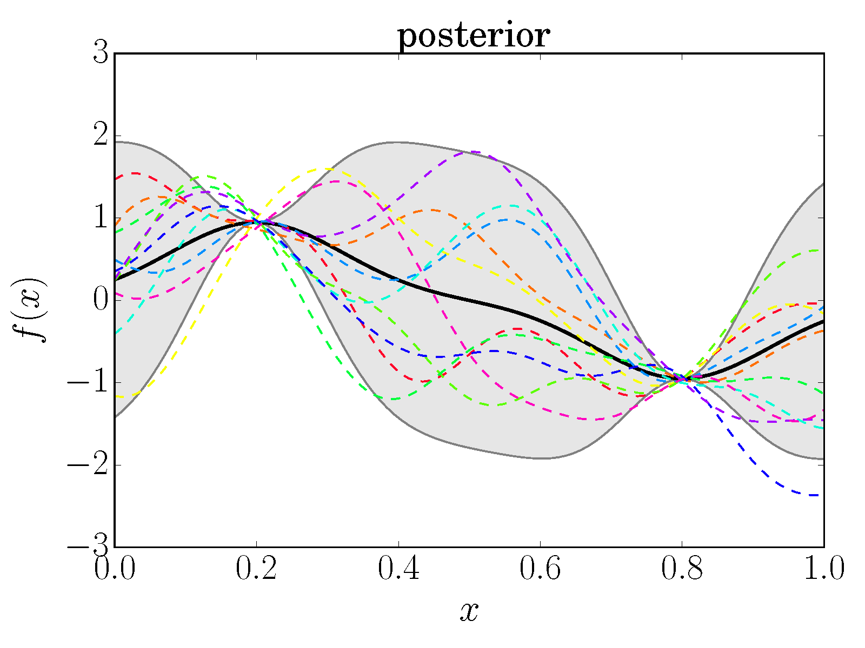
Gaussian Processes for Bayesian Modeling
Some
Function
Some Feature
Notes:
Here is a typical example of Bayesian Modeling using a GP. The objective is to predict the underlying function f(x)
We start off with some prior where we have no initial data. So in this case we will just assume that it’s a zero function with standard variance. The black line here is the mean prediction, and the shaded region represents the uncertainty. Because this is a distribution, I can sample multiple functions from this, and you can see that they mostly lie in the shaded region and are on average zero.
After we add in two observations at x = 0.2 and 0.8, we update our distribution to a posterior. You can see two things here. Firstly, at places where we have observation, the variance decreased to zero, because we are now certain about the prediction there. Secondly, you can see the concept of covariance here. Places closer to the observations have their means pulled closer and their variance smaller, which shows how inference can be done at places it hasn’t observed.

Slide 18


Gaussian Processes for Bayesian Modeling
Notes:
But wait! Benthic Habitat Mapping is a classification problem, where we try to determine the habitat types! The output of our model should be discrete! But the way I’m talking about GPs here sound like it’s used for regression problems, where outputs are continuous. So how do use GPs for classification?

Slide 19
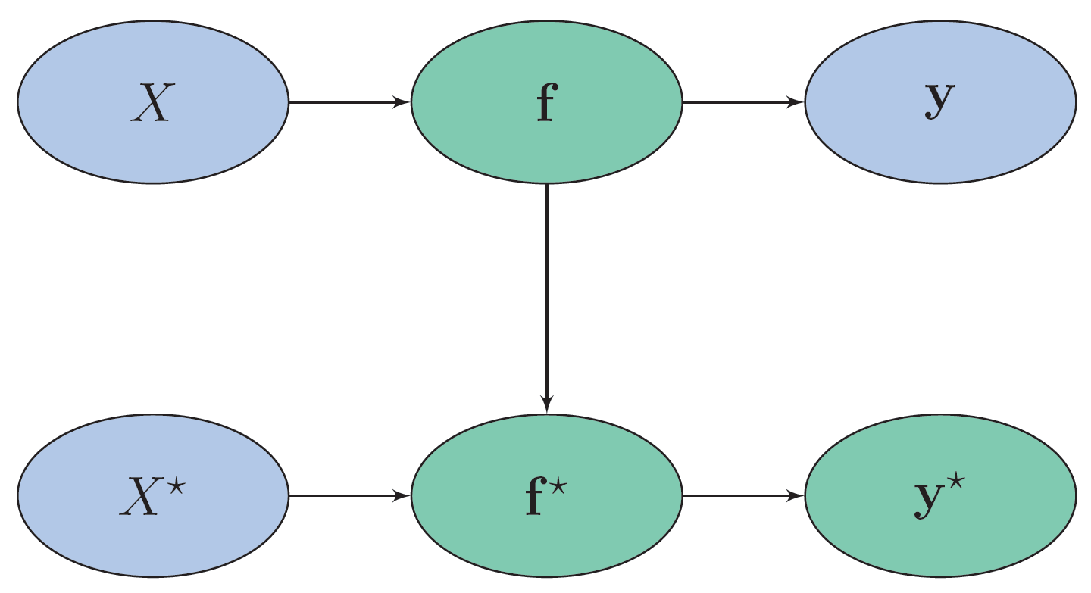
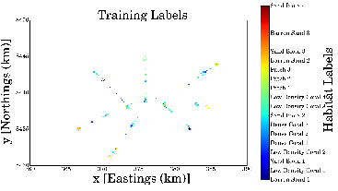
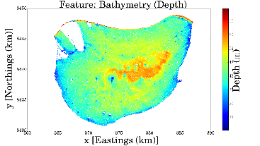
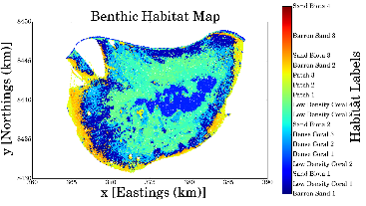
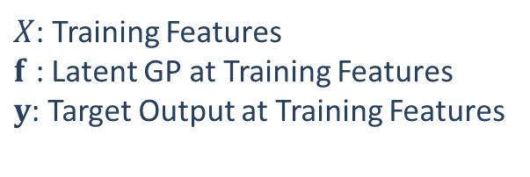
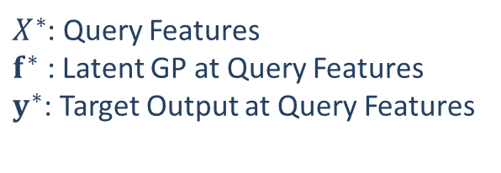
Gaussian Processes Classifiers
$X$: Training Features
$f$ : Latent GP at Training Features
$y$: Target Output at Training Features
Gaussian processes as an
intermediate latent function
$X^{∗}$: Query Features
$f^{∗}$ : Latent GP at Query Features
$y^{∗}$: Target Output at Query Features
Notes:
In fact Gaussian processes are the middle man in our model. Here’s a really simple graphical model that will show you what I mean.
Here, the blue clouds are things that we know, which are: bathymetry and habitat types at training Locations, and bathymetry at places we want to infer the habitats for, which are our query features. The green clouds are things we need to infer.
The idea is that during the training stage, we learn a latent function that aims to explain the type of habitats we have observed. Here latent just means that it’s not directly observed.
And the way you interpret this latent function is like this: Let’s just talk about a binary case where you want to classify between two objects, an apple and an orange. So your output is either y = apple or y = orange. The latent function would then represent the ‘apple-ness’ of the observations (explain with hands).
Now, this latent function is now continuous, so we model this as a GP, which can tell us about the latent functions at places we have not observed, which allows use to infer the type of habitats there.

Slide 20
Gaussian Processes Classifiers
$X$: Training Features
$f$ : Latent GP at Training Features
$y$: Target Output at Training Features
Gaussian processes as an
intermediate latent function
$X^{∗}$: Query Features
$f^{∗}$ : Latent GP at Query Features
$y^{∗}$: Target Output at Query Features
Notes:
In fact Gaussian processes are the middle man in our model. Here’s a really simple graphical model that will show you what I mean.
Here, the blue clouds are things that we know, which are: bathymetry and habitat types at training Locations, and bathymetry at places we want to infer the habitats for, which are our query features. The green clouds are things we need to infer.
The idea is that during the training stage, we learn a latent function that aims to explain the type of habitats we have observed. Here latent just means that it’s not directly observed.
And the way you interpret this latent function is like this: Let’s just talk about a binary case where you want to classify between two objects, an apple and an orange. So your output is either y = apple or y = orange. The latent function would then represent the ‘apple-ness’ of the observations (explain with hands).
Now, this latent function is now continuous, so we model this as a GP, which can tell us about the latent functions at places we have not observed, which allows use to infer the type of habitats there.

Slide 21
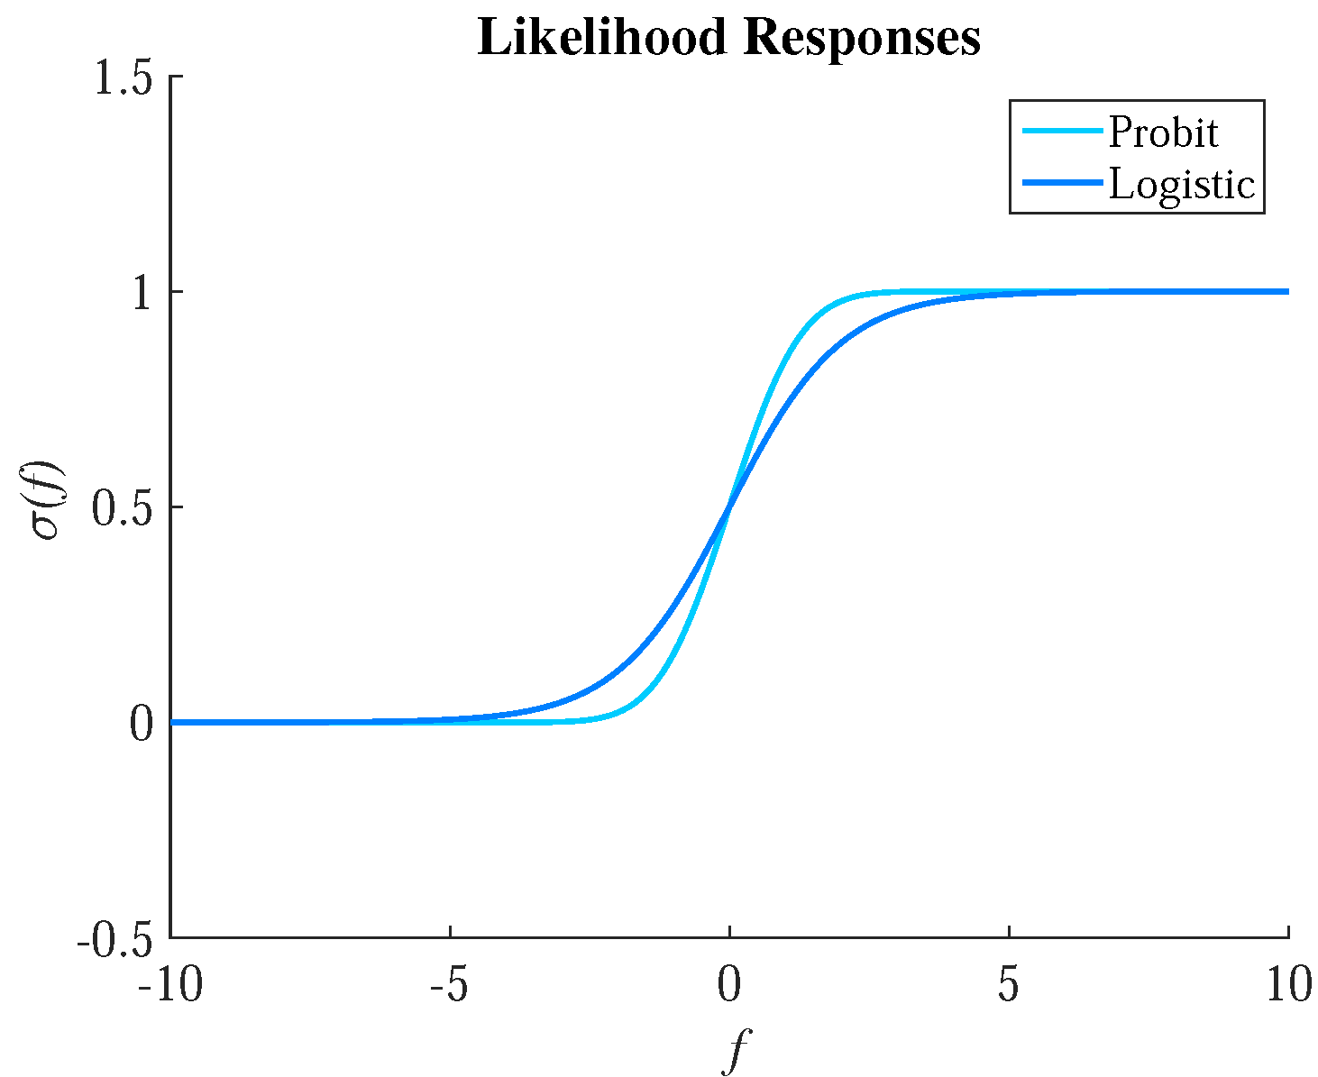
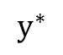
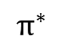
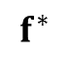
Gaussian Process Classifiers
The class with the highest probability is the predicted class
$$f^{∗}$$
$$π^{∗}$$
$$y^{∗}$$
Latent Function
Predictive Probabilities
Prediction Classes
Notes:
Now, since this is a Bayesian model, we’re outputting probabilities. For simplicity here is the case for a binary classification scenario. You have a latent function that determines the “appleness”, and you want to squash that into the probability that it is an “apple”. The way you squash it is done by a likelihood function which is usually a logistic or probit function. If the probably is greater than 0.5, we’ll say it’s an apple, and if not, it’s an orange.
Make sure this is explained properly

Slide 22
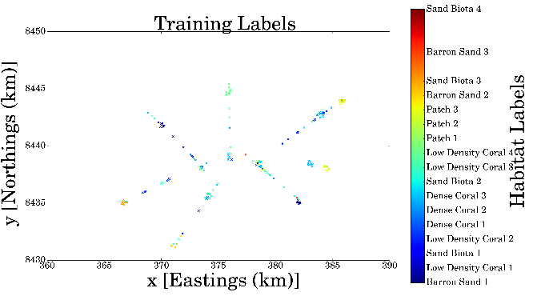
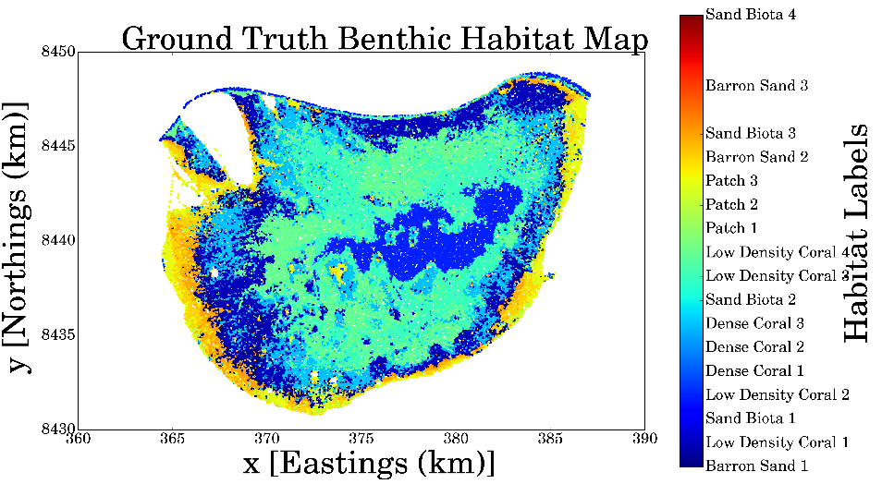
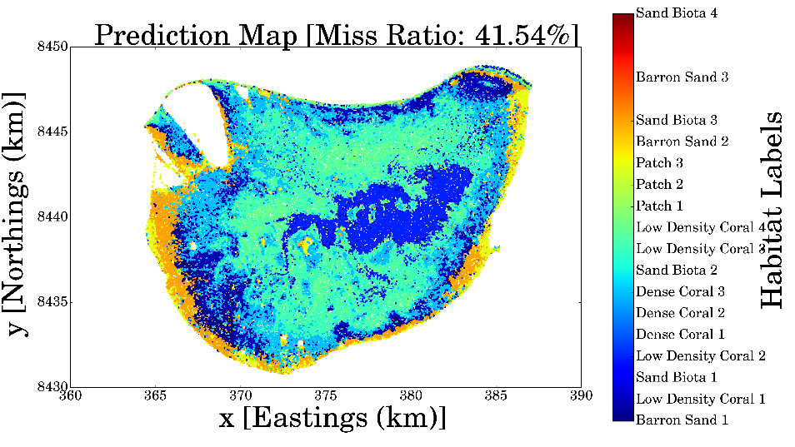
Mapping Benthic Habitats at Scott Reef
Almost 60% Mapping Accuracy
from just 200 observations
Ground Truth
Prediction of Benthic Habitats
Notes:
Here is the result of applying the GP model to the Scott Reef Data. Here I have only given it 200 training points from past mission tracks, which barely covers the area, and it is able to achieve a mapping accuracy of almost 60%. Notice that the mapping accuracy criteria here is very harsh, it’ll count the prediction wrong even when you say it’s Sand Biota 1 when it’s actually Sand Biota 2. This shows you the power of applying Gaussian process models on bathymetric features, which allows you to infer places that are potentially far away.
Describe how we got the ground truth

Slide 23


Informative Seafloor Exploration: Acquisition Functions
Measures desirability of a candidate path
More Information -> More desirable
What is the best way to measure information?
Notes:
Now that we can build a map, we can start trying to develop an exploration policy!
The most important concept in informative path planning is “Acquisition Functions”. They measure the desirability of a candidate path. For us, we because we are trying to map out a region, we want to find the most informative places, so more information means more desirable. But how do we quantify the amount of information along any given path? (refer to diagram)

Slide 24
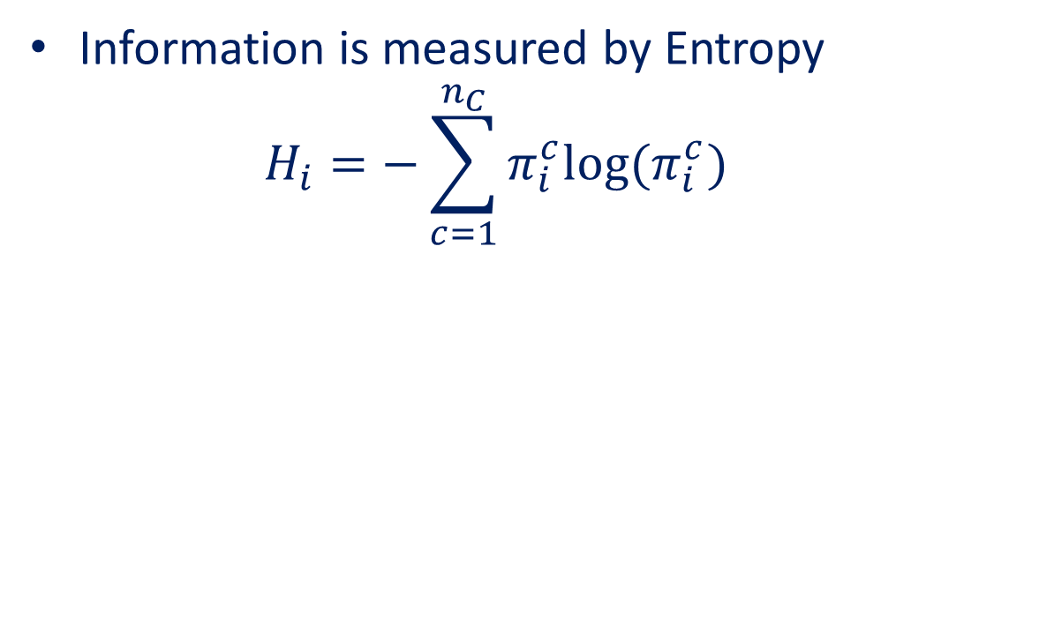
Informative Seafloor Exploration: Acquisition Functions
Information is measured by Entropy
$$H_{i}=−\sum_{c=1}^{n_{C}}{π_{i}^{c}log⁡(π_{i}^{c}) }$$
Notes:
In most cases, information is captured by some sort of entropy measure.

Slide 25

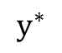
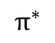
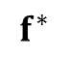
Informative Seafloor Exploration: Acquisition Functions
Information is measured by Entropy
$$H_{i}=−\sum_{c=1}^{n_{C}}{π_{i}^{c}log⁡(π_{i}^{c}) }$$
Entropy of $y$
$$f^{∗}$$
$$π^{∗}$$
$$y^{∗}$$
Latent Function
Predictive Probabilities
Prediction Classes
Notes:
And this entropy depends on the predictive probabilities of your model, which we get from the likelihood squashing from just now.
But there is a complication when you find the entropy of a path with a classification model: The transformation from the latent function f to the output y actually gets rid of the joint distribution from the latent functions!

Slide 26
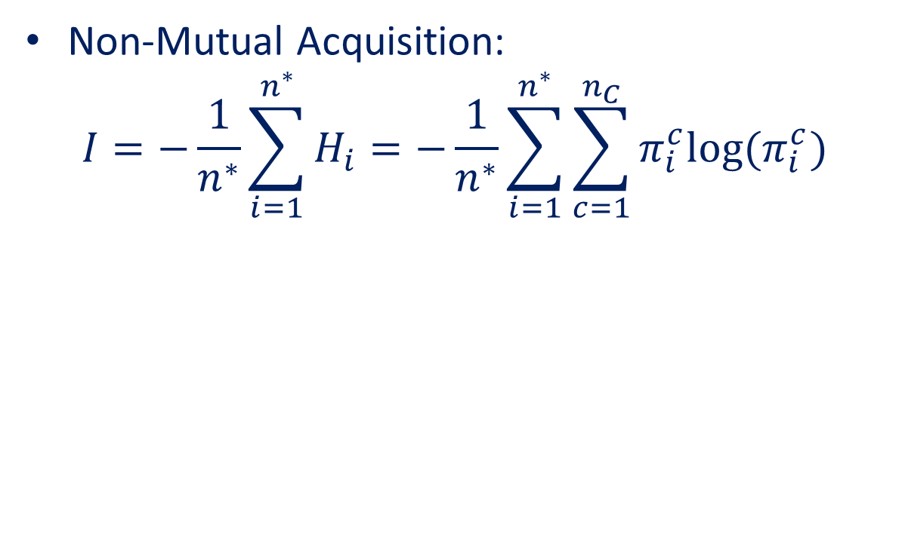
Informative Seafloor Exploration: Acquisition Functions
Non-Mutual Acquisition:
$$I=−\frac{1}{n^{∗}}\sum_{i=1}^{n^{∗}}{H_{i}}=−\frac{1}{n^{∗}}\sum_{i=1}^{n^{∗}}{\sum_{c=1}^{n_{C}}{π_{i}^{c}log⁡(π_{i}^{c}) }}$$
Has
Joint
Distribution
No Analytical
Joint Distribution
$$f^{∗}$$
$$π^{∗}$$
$$y^{∗}$$
Latent Function
Predictive Probabilities
Prediction Classes
Monte Carlo?
Notes:
What this means that we only have the entropy of each location SEPARATELY, not together. We call this type of acquisition non-mutual. And what tends to happen when you use non-mutual acquisitions is that your path shrivels up if it finds a local maximum. Imagine… (explain)
Now to get a joint entropy you can try to use Monte Carlo methods, but for them to be accurate you would need quite a bit of samples which can take a lot of computational time.

Slide 27
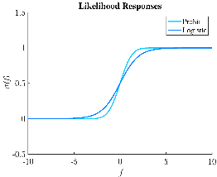
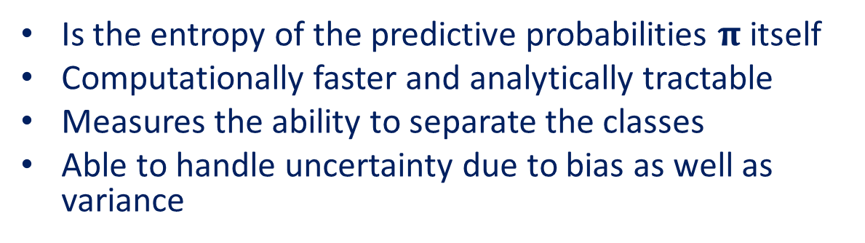
Linearised Model Differential Entropy
Is the entropy of the predictive probabilities $π$ itself
Computationally faster and analytically tractable
Measures the ability to separate the classes
Able to handle uncertainty due to bias as well as variance
Linearise to approximate
Joint Distribution
Has
Joint
Distribution
No Analytical
Joint Distribution
$$f^{∗}$$
$$π^{∗}$$
$$y^{∗}$$
Latent Function
Predictive Probabilities
Prediction Classes
Notes:
Instead, we developed this new entropy measure called Linearised Model Differential Entropy. This is the entropy of the prediction probabilities itself, which we can compute because it is simply some smooth transformation of the latent function.
But wait, you say: That isn’t’ the entropy of the predictions anymore. And you’re right. This is not meant to approximate the prediction entropy. It is a new entropy measure that measures the ability to separate the classes. In fact, it can be show to be able to handle both uncertainty due to both bias and variance. Plus it’s computationally faster and analytically tractable.

Slide 28
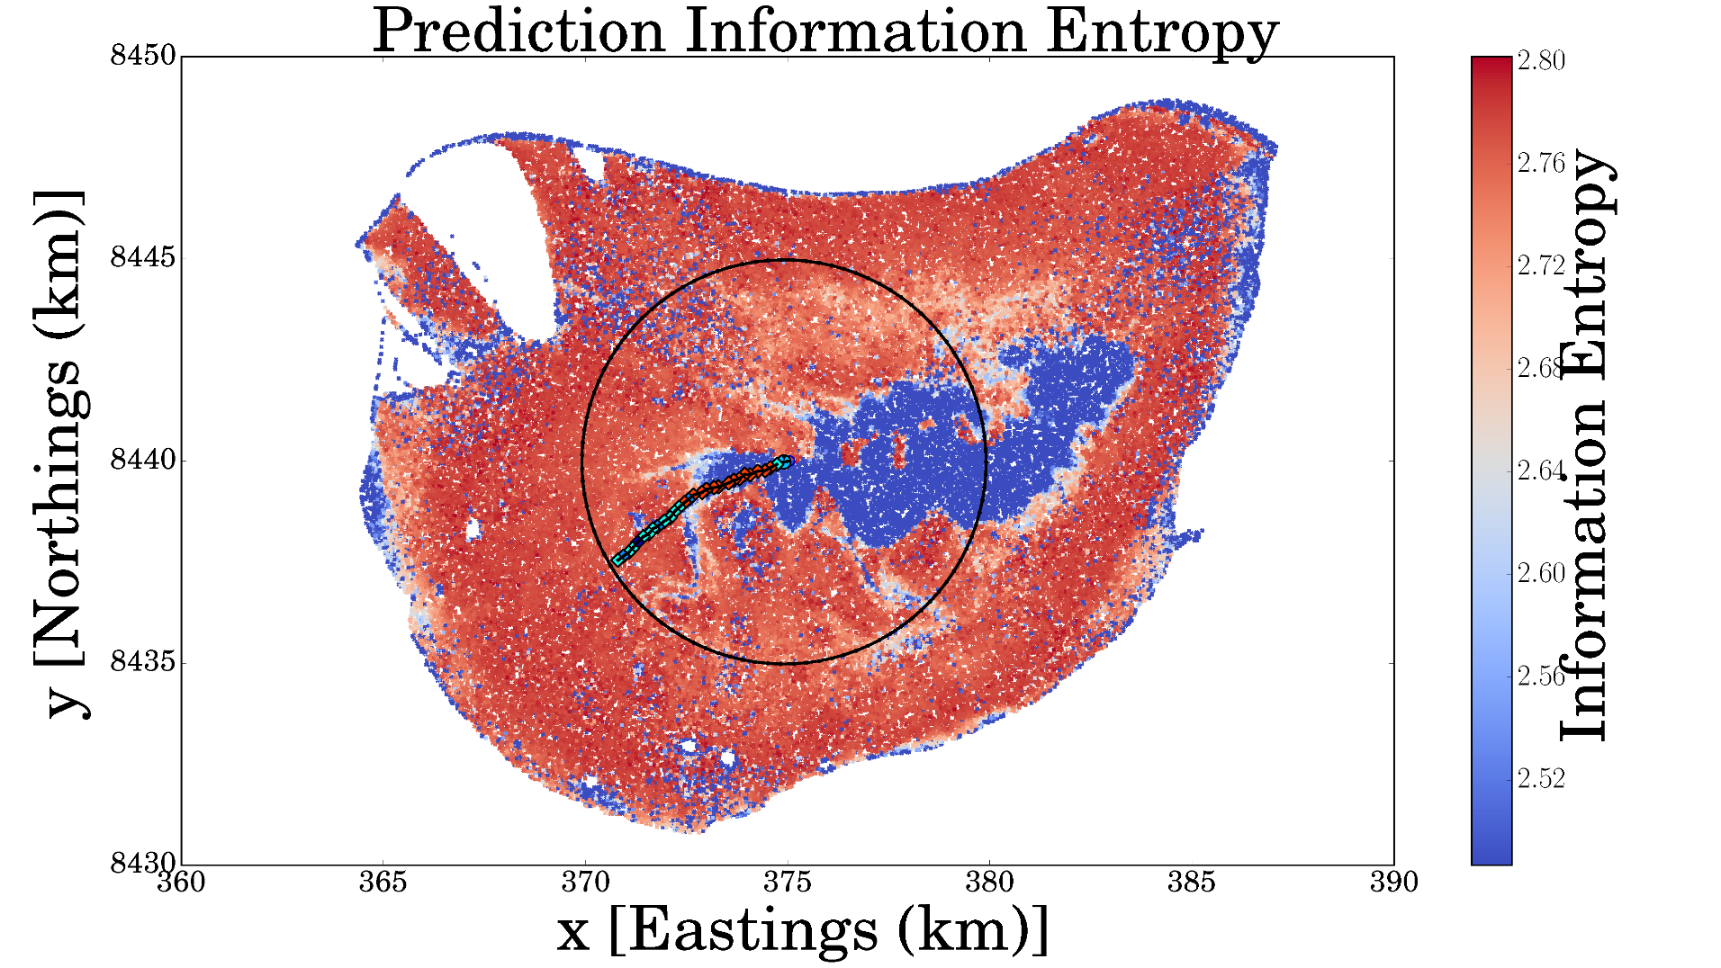
Receding Horizon Formulation
Notes:
Now that we have an acquisition function, we need to develop a path planning scheme. And we want this to be non-myopic, which means that we want the path planner to plan for the future and not just for the immediate information gains.
Here we have formulated a receding horizon approach, where the vehicle would find the optimal path of a finite length with the most information, take one step into it, and repeat the process.

Slide 29

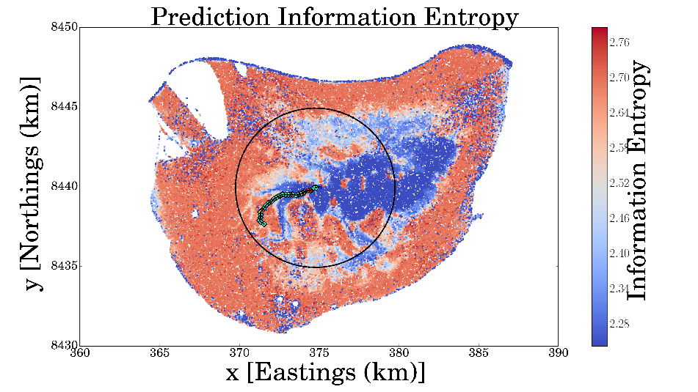
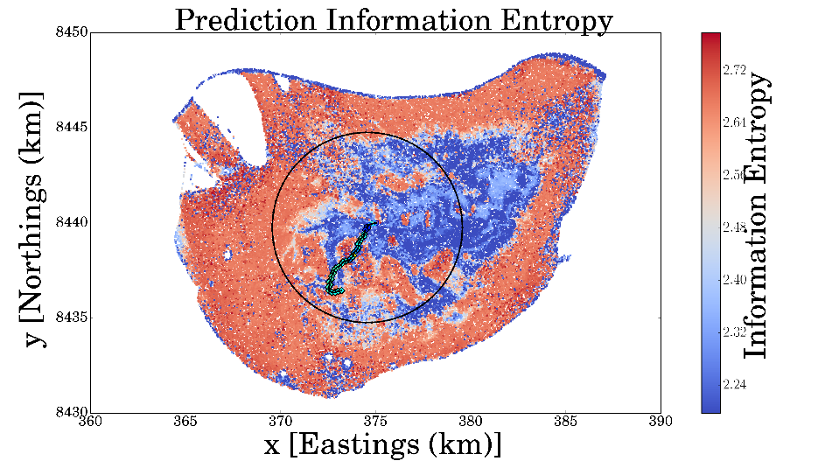
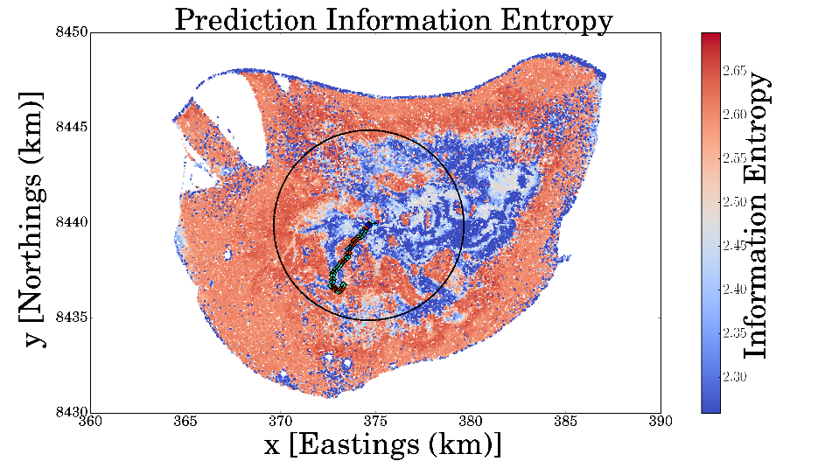
Receding Horizon Formulation
Notes:
Here is what it looks like it travels.

Slide 30
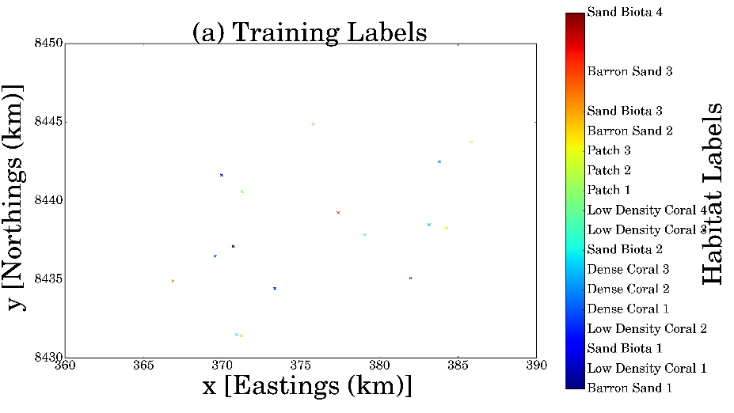
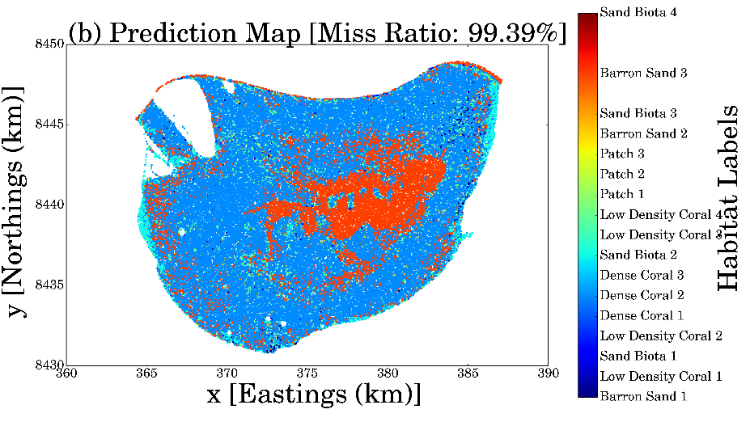
Initial Situation at Scott Reef
Notes:
Now we are ready to test this on the Scott Reef dataset.
Describe Scenario

Slide 31
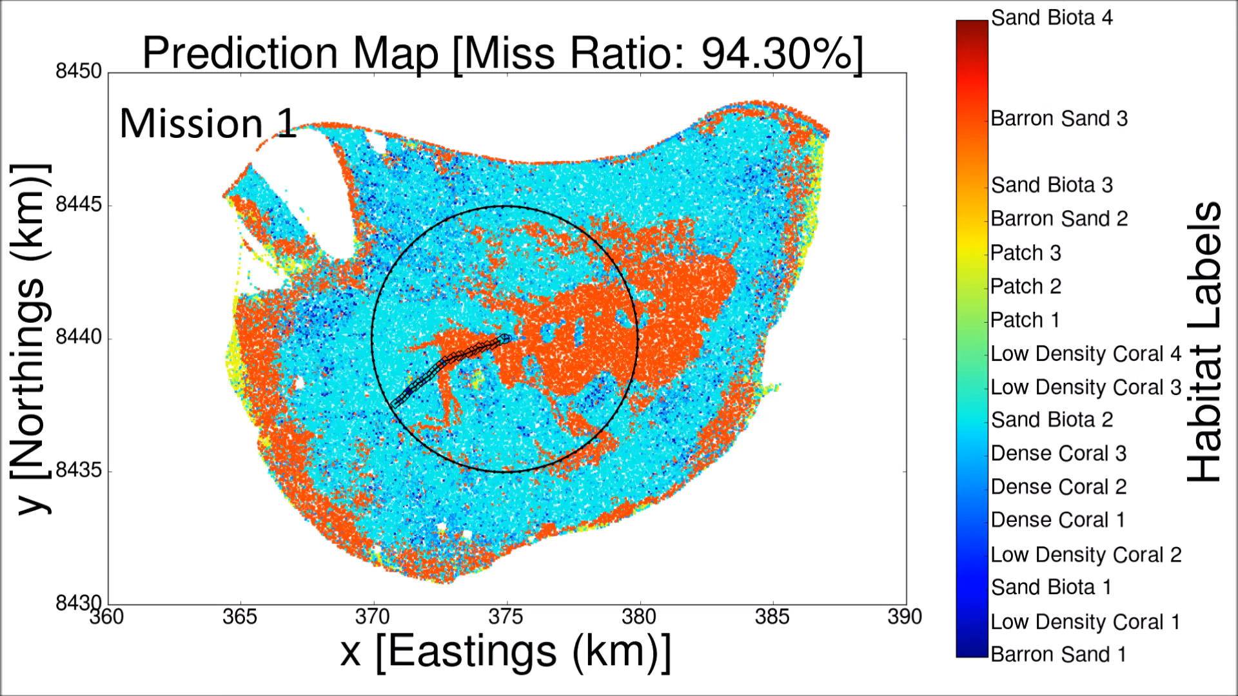
Informative Seafloor Exploration at Scott Reef

Slide 32
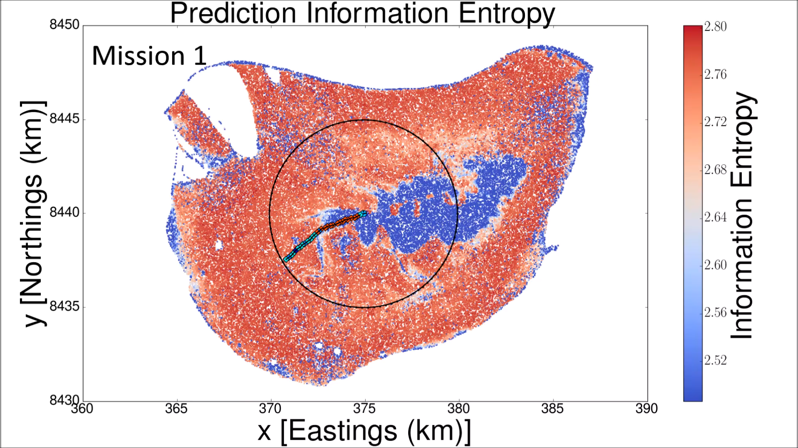
Informative Seafloor Exploration at Scott Reef

Slide 33
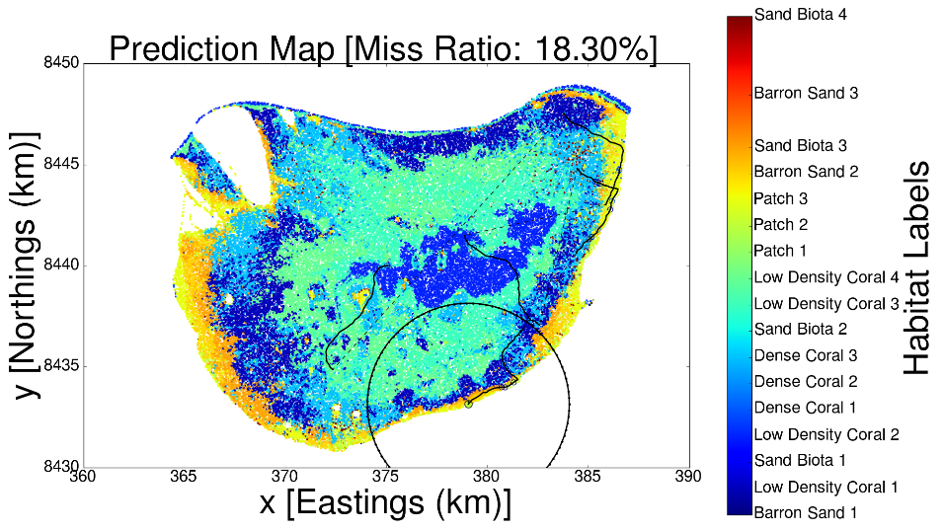
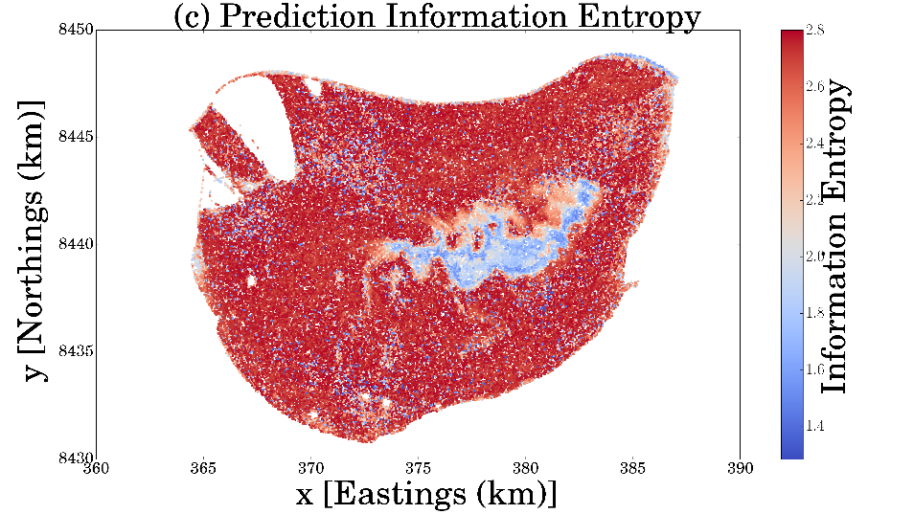
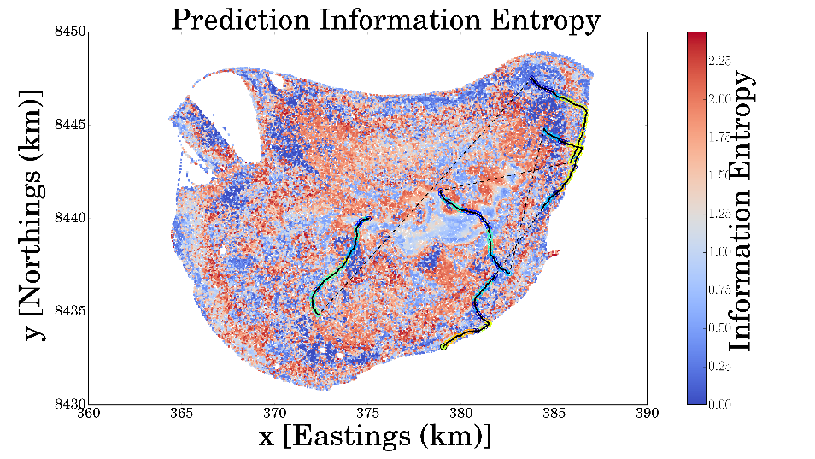
Before… After…

Slide 34
Ground Truth… After…

Slide 35
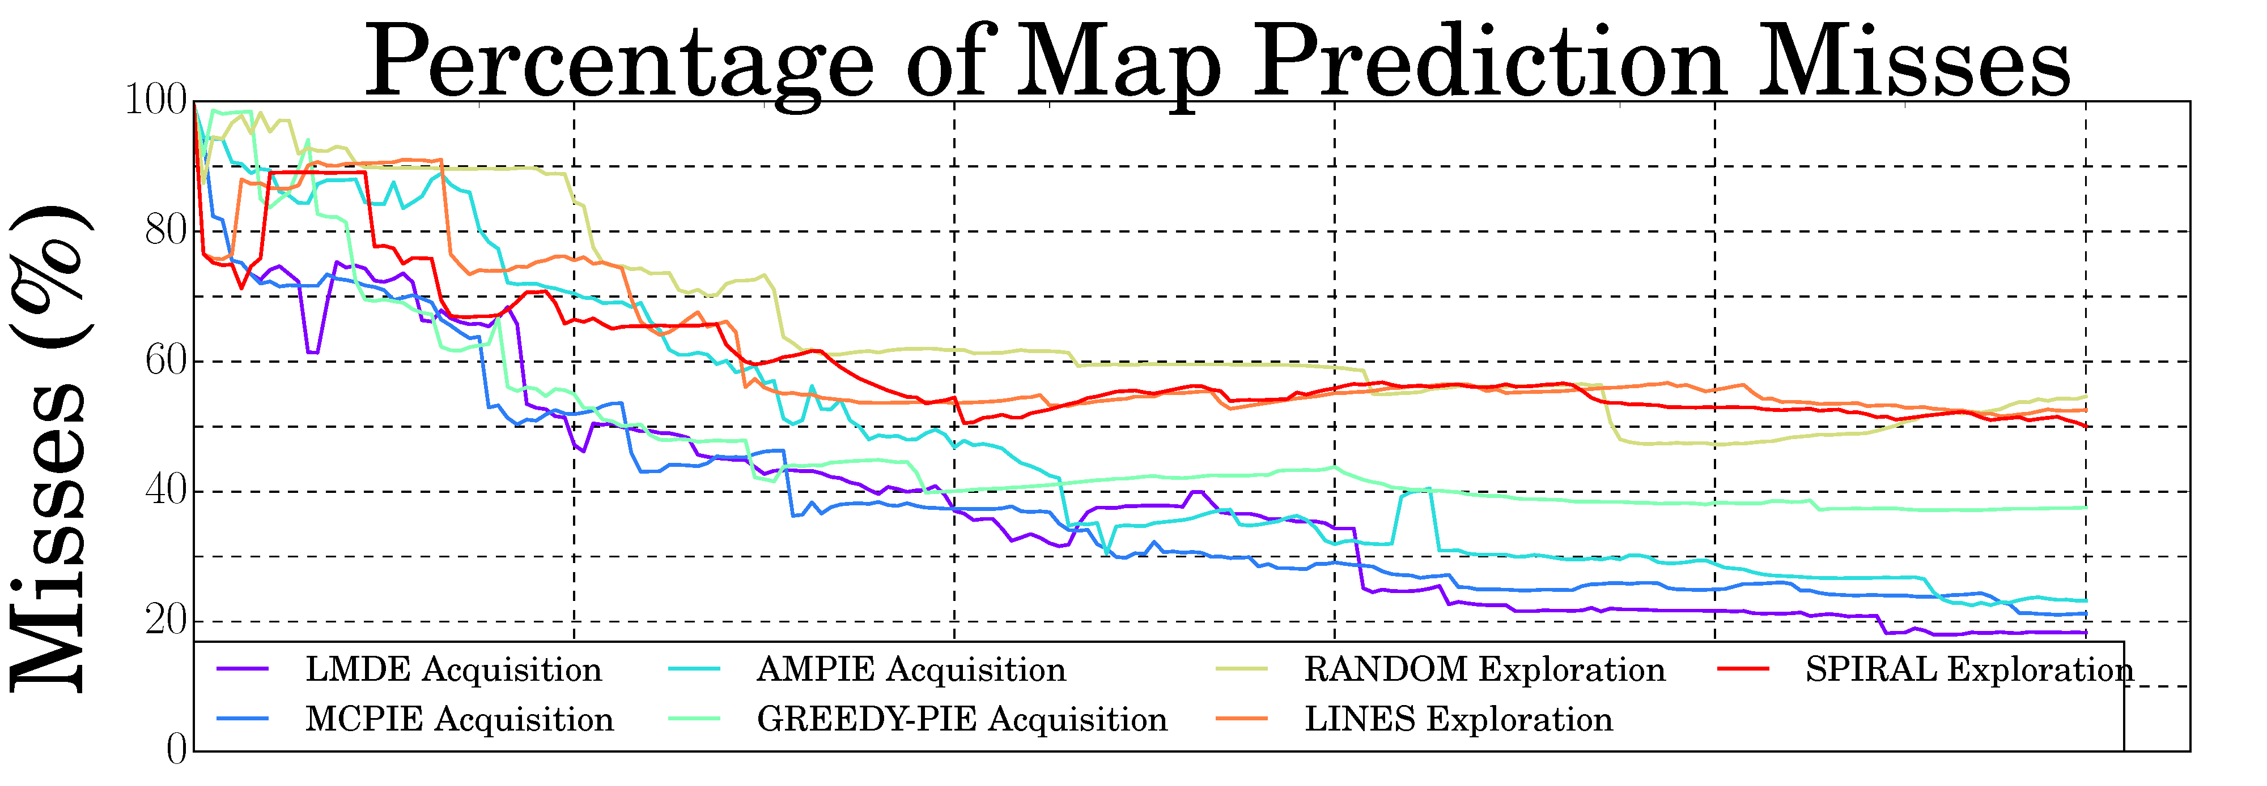
Comparison with Other Exploration Policies
Policy | LMDE | MCPIE | AMPIE | GREEDY | RAND | LINES | SPIRAL
Informative | Yes | Yes | Yes | Yes | No | No | No
Non-Myopic | Yes | Yes | Yes | No | No | Yes | Yes
Mutual | Yes | Yes | No | No | No | No | No
Mission Time

Slide 36
Final Mapping Error (%) after five 6.6 km missions
Policy | LMDE | MCPIE | AMPIE | GREEDY | RAND | LINES | SPIRAL
Test 1 | 18.30 | 21.22 | 23.21 | 37.54 | 54.63 | 52.54 | 50.06
Test 2 | 16.44 | 22.99 | 32.11 | 43.86 | 34.87 | 20.40 | 33.74
Test 3 | 20.38 | 27.01 | 40.11 | 37.63 | 35.68 | 25.05 | 43.16
Mission Time

Slide 37
Final Mapping Error (%) after five 6.6 km missions
Policy | LMDE | MCPIE | AMPIE | GREEDY | RAND | LINES | SPIRAL
Test 1 | 18.30 | 21.22 | 23.21 | 37.54 | 54.63 | 52.54 | 50.06
Test 2 | 16.44 | 22.99 | 32.11 | 43.86 | 34.87 | 20.40 | 33.74
Test 3 | 20.38 | 27.01 | 40.11 | 37.63 | 35.68 | 25.05 | 43.16
Mission Time

Slide 38
Thank You!
Special Thanks to
Stefan Williams
Simon O’Callaghan
Alistair Reid

Slide 39
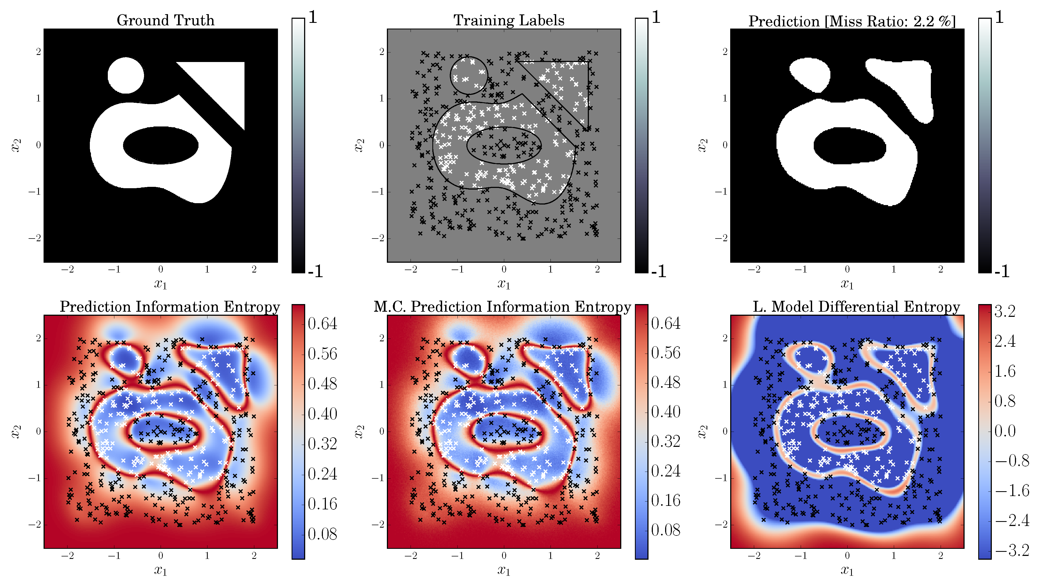
Prediction Information Entropy V.S. Linearised Model Differential Entropy
Notes:
It also has some very nice properties. Here is a simple example where we have two classes with labels 1 and -1 and a lot of data. We can see that the Monte Carlo approach, after many samples, converges to the prediction information entropy. However, under abundant data, we would really like the entropy measure to focus on the boundaries between the classes, because that’s where we’re actually uncertain about. However, you can see that the prediction entropy is also quite high at places where there is still data, because it’s close to places without data. If we use this for acquisition, the vehicle would still be tempted to explore those places even though we’re actually quite certain already. Instead, the linearised model differential entropy strikes a good balance between boundaries and unobserved places.

Slide 40
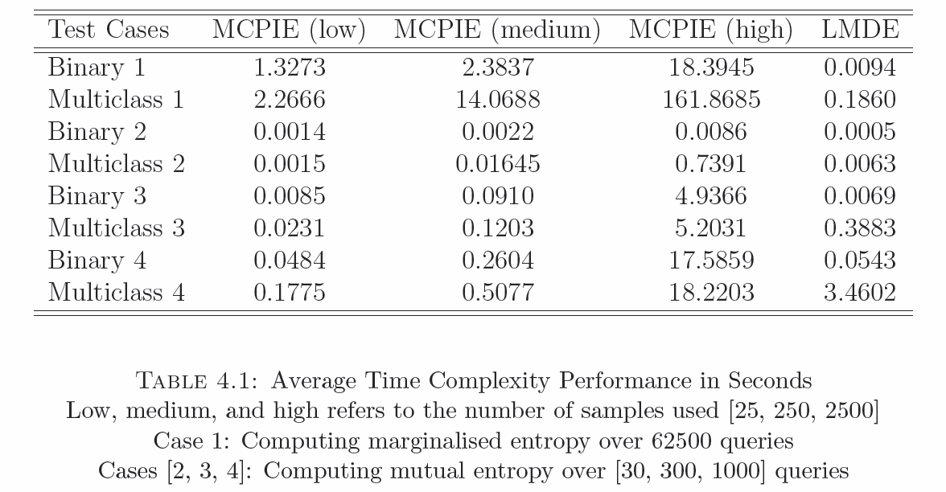
Computational Time
Notes:
It also has some very nice properties. Here is a simple example where we have two classes with labels 1 and -1 and a lot of data. We can see that the Monte Carlo approach, after many samples, converges to the prediction information entropy. However, under abundant data, we would really like the entropy measure to focus on the boundaries between the classes, because that’s where we’re actually uncertain about. However, you can see that the prediction entropy is also quite high at places where there is still data, because it’s close to places without data. If we use this for acquisition, the vehicle would still be tempted to explore those places even though we’re actually quite certain already. Instead, the linearised model differential entropy strikes a good balance between boundaries and unobserved places.

